Slide 1





Nutrient Dynamics in Streams of Four Land Use Types in the Lake Champlain Basin
Allison Jerram, Andrew Schroth, Breck Bowden, Matthew Vaughan, Jamie Shanley, Andy Vermilyea

Slide 2

Research Questions
How do nutrient concentrations in streams differ among land use types over time?
How does nutrient loading during storms differ among land use types?

Slide 3
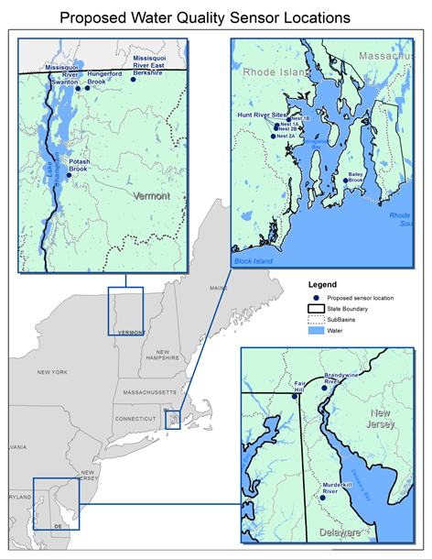
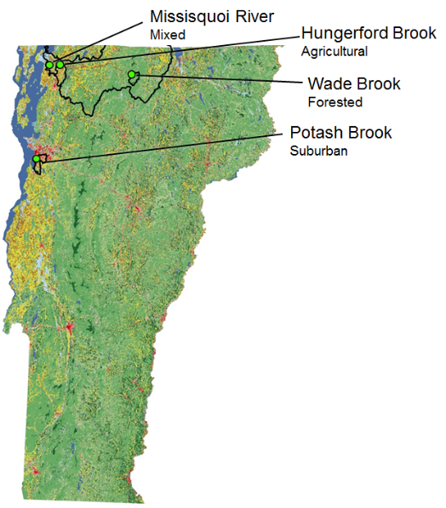
Strategy and Site Selection
Deploy identical in situ sensor suites in streams in Rhode Island, Delaware, and Vermont

Slide 4
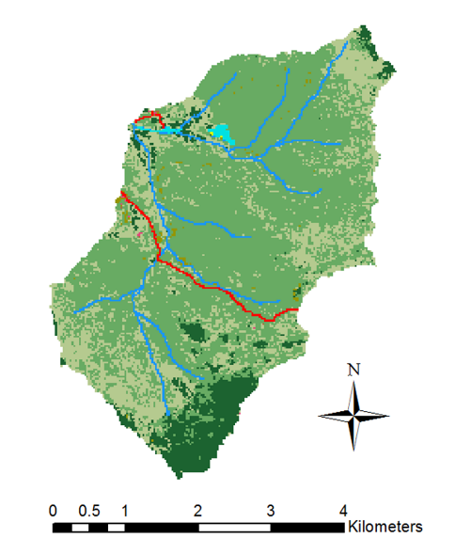
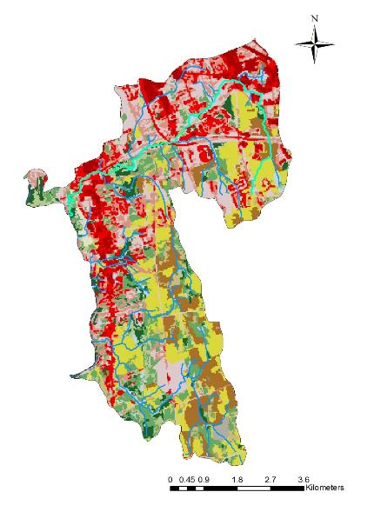
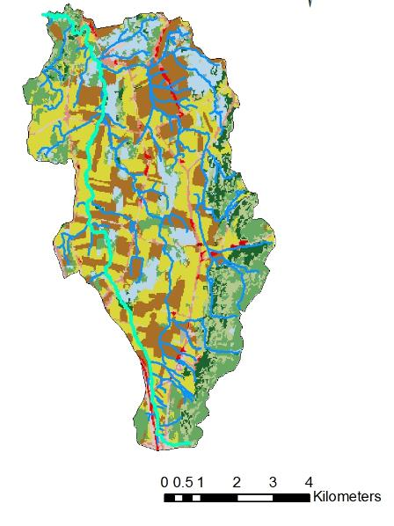

Potash Brook
Suburban
Land Cover for 3 VT Endmembers
Wade Brook
Forested
Hungerford Brook
Agricultural
Notes:
Contrast between 2 land use types (too much to show all 4?)

Slide 5
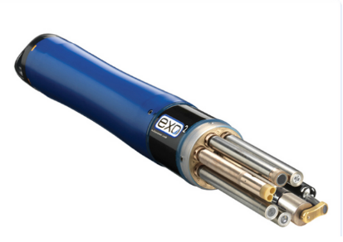
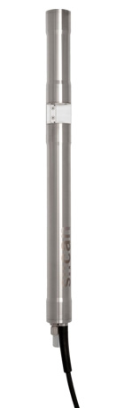
Sensor Selections
YSI EXO2
  Conductivity
  Dissolved Oxygen
  pH
  Turbidity
  Fluorescent Dissolved Organic Matter(fDOM)
  BGA/Chlorophyll
s::can Spectrolyser
  Nitrate-N
  Dissolved Organic Carbon
  Total Organic Carbon
  Turbidity
  Full UV/Visible ‘Fingerprint’ scan
Both sensors: 15 minute resolution

Slide 6
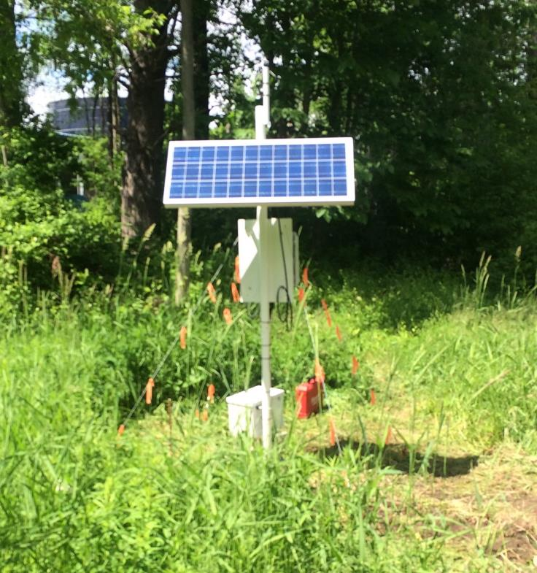
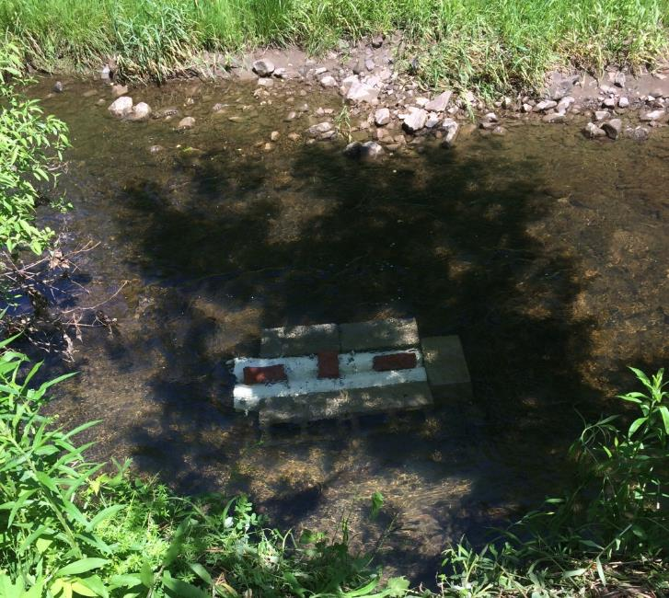
Field Installations
- Suburban
Solar panel
s::can sensor
Datalogger
Battery Box
EXO2 sensor

Slide 7
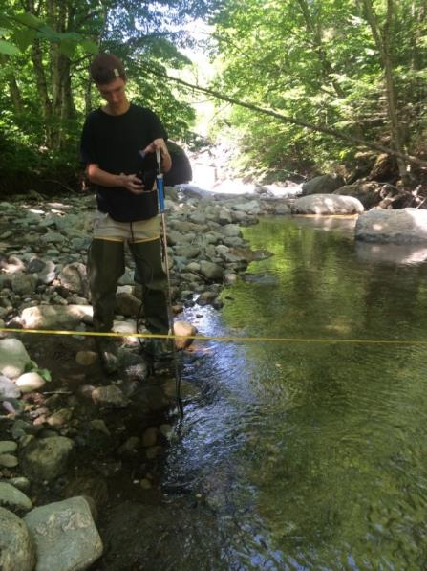
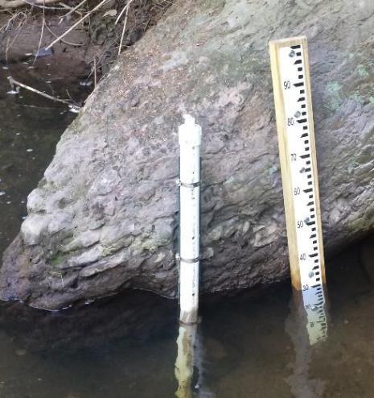
Discharge Data
Rating curves were developed for the forested and suburban site
USGS data were used for the agricultural and mixed sites

Slide 8
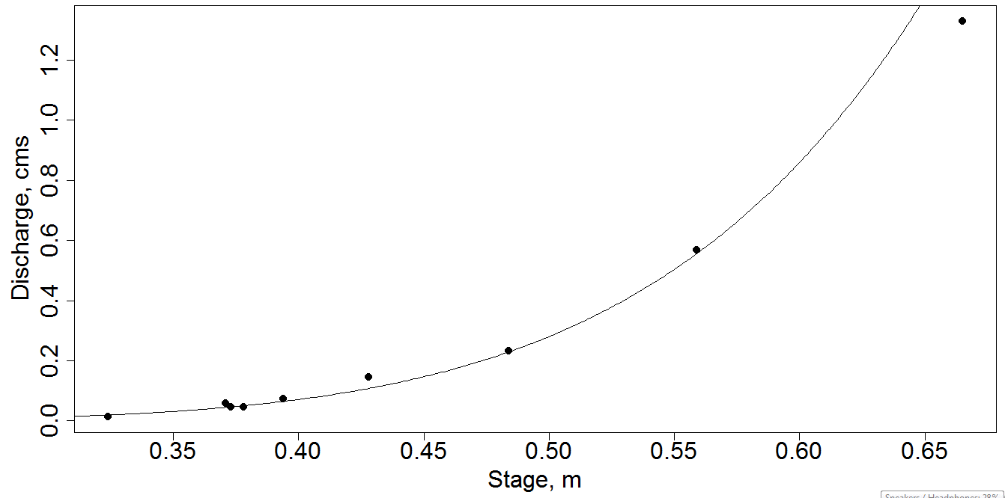
Forested Site Rating Curve

Slide 9
Variability in Nitrate Across Sites

Slide 10
Relationship of Storm Discharge to Nutrient Export
How much of a certain nutrient enters the stream (and exported downstream) during a storm?
How is storm export different among land use types for a storm of the same size? How does this vary across storms and seasons?
Must normalize discharge and concentration data by including area in calculation

Slide 11
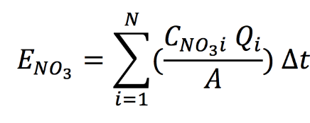
Nitrate Export During Storms

Slide 12
Y = 0.03x+0.10, R²=0.42
Y = 2.53x-0.55, R²=0.92
Y = 0.82x+0.13, R²=0.95

Slide 13
Questions?

Slide 14
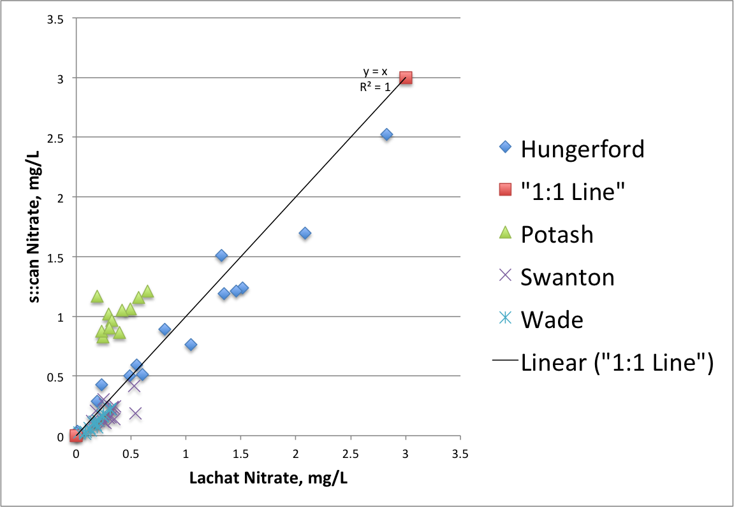
Sensor QA/QC – Nitrate

Slide 15
Sensor QA/QC – DOC

